Slide 1

MIS 547
Cloud Computing

Slide 2

Admin
Hmm
01
uhh
03
mmmm
04
huh
02

Slide 3
AGENDA
What’s covered in this lecture
Agenda
What’s covered next
Observability
Time for Projects, questions, recaps, etc.
Monitoring
Observability
Tracing
Exam 2 Prep!

Slide 4
Lecture 17
Observability

Slide 5
We’ve built this thing and now we need to understand it??

Slide 6
How Do We know what’s happening in our systems?
Telemetry
Collection and automatic transmission of data from sensors, processes, logs, etc.
Supporting pillar
Metrics
Quantitative measurements that are used to track and analyze performance over time.
Can be presented in various formats such as graphs, charts, tables
Monitoring
An action that you take to detect anomalies

Slide 7
Kinds of Monitoring
Availability monitoring
Application performance monitoring
Site reliability
API monitoring
Real user monitoring and synthetic monitoring
Security monitoring

Slide 8
Challenges with monitoring
Data gaps
Sample data
Slow movement
Missing intelligence
Tool sprawl

Slide 9
How Do we Know if We Are Going to Be Able to Understand our system?

Slide 10
Questions to ask
Can you answer open-ended questions about the inner workings of your applications to explain anomalies without hitting dead ends?
Can you understand what any particular user of your software may be experiencing at any given time?
Can you quickly see any cross-section of system performance you care about, from top-level aggregate views to single and exact user requests?
Can you compare any arbitrary groups of user requests in ways that let you identify commonalities for users experiencing unexpected behavior?

Slide 11
Questions to Ask, cont.
Can you pivot from one attribute within one user request to identify all user requests with that attribute?
Can you identify which system user is generating the most load?
Can you identify which of those most-load-generating users only recently started impacting performance?

Slide 12
Questions to aSk, cont.
Can you answer these kinds of questions without first needing to predict that you need to ask them?
Can you get answers to questions like these quickly so that you can iteratively ask a new question, and another, and another (answers within seconds, not minutes)
Can you quickly (e.g., within minutes) isolate faults in your system, no matter how complex, deeply buried, or hidden within your stack?

Slide 13
Observability

Slide 14
What is Observability?
Mathematical definition (Kalman, 1960):
A measure of how well internal states of a system can be inferred from knowledge of its external outputs
Application to software systems:
Understand the inner workings of your application
Understand any system state your application may have gotten itself into (including new states and ones you have never seen before/couldn’t predict)
Understand the inner workings and system state solely by observing and interrogating with external tools
Understand the internal state without shipping any new custom code to handle it

Slide 15
Observability definition
A measure of how well you can understand and explain any state your system can get into, no matter how novel or bizarre.
If you can understand any bizarre or novel state without needing to ship new code, you have observability.

Slide 16
Observability Definition, cont.
Fundamentally, observability is about how people interact with and try to understand complex systems.

Slide 17
Telemetry, monitoring, and observability
Telemetry
The data that systems make available to make them more observable. Logs, metrics, traces, profiles, etc.
Monitoring
The act of reading combining, analyzing the telemetry to make decisions based on it.
Helps you answer questions about known unknowns (bandwidth usage, up/down servers, errors per minute)
Observability
The level at which a system as a whole or a subsystem is observable. Different systems have different observability properties that make it more or less observable.
Helps you answer questions about unknown unknowns (how many errors did people named Steve have after logging into this app from 1-2pm)

Slide 18
Systems where monitoring + Metrics were sufficient
Monolith
One stateful data store (“the database”)
Low-level system metrics are available (memory, CPU load average)
Fairly static and long-running set of nodes, containers, or hosts to monitor
Focus is uptime and failure prevention
Examination of correlation occurs across a limited (or small) number of dimensions

Slide 19
Reality of Modern Systems
Application has many services
Many databases and storage systems (polyglot persistence)
Infrastructure is dynamic and elastic
Many far-flung and loosely coupled services are managed
Focus is on how to tolerate constant and continuous degradation while building resiliency to user-impacting failures
Examination of correlation occurs across a virtually unlimited number of dimensions

Slide 20
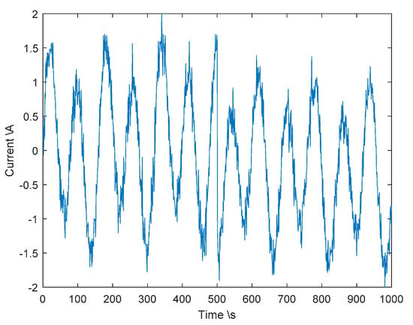
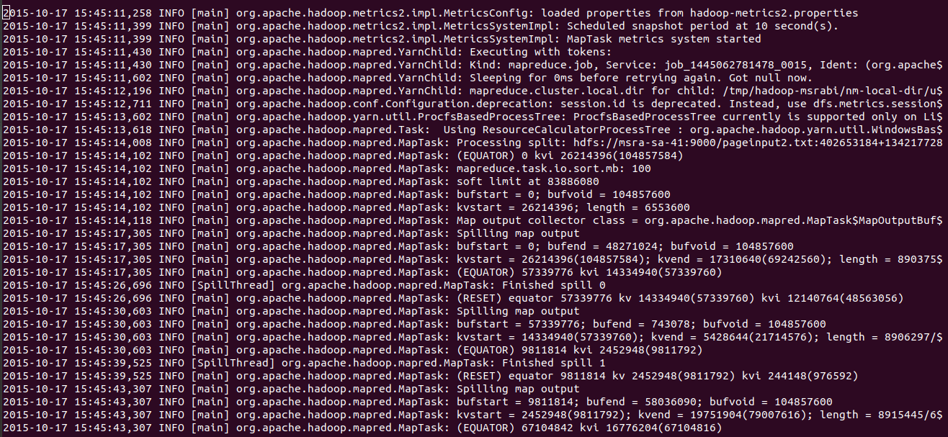
Telemetry data
Observability relies on three data types:
Telemetry Data:
Logs, metrics, events, traces created by an application, sensor, etc.
Metrics: values measured over time
Traces: end-to-end journey of a request across a distributed system

Slide 21
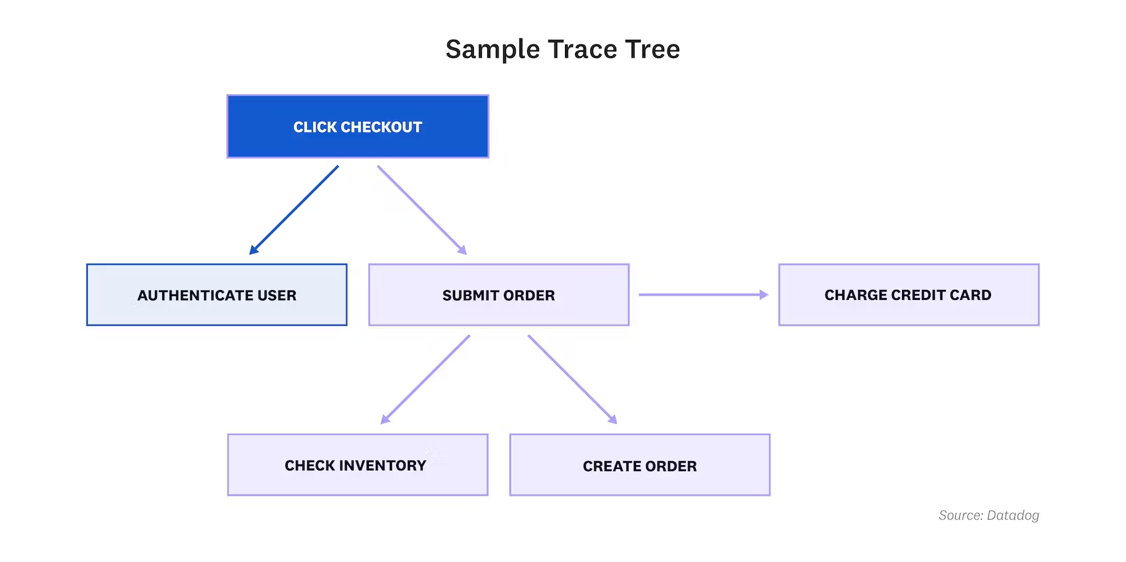
Tracing
Tracing applications means having the ability to run through the application code and ensure it’s doing what is expected.
How to do this in a distributed application environment?
Distributed tracing!
How do we do this?
OpenTelemetry framework

Slide 22
What Does a System need to be observable?
Instrumentation tools:
Collect telemetry data from various components (hosts, applications, services, containers, etc.)
The ability to process and correlate telemetry data
If analyzing data in isolation, you’re limiting the insights you can glean
Root cause analysis:
Trace issues to their root cause
Automation, including incident response actions
Support incident management and ongoing incident automation -> inform the right people
Machine learning and AI operations
Automatically correlate and prioritize incident data; filter out alert noise

Slide 23
Observability use cases
Solving application performance issues faster
Automating more processes for more teams
Building security and resilience
Delivering great end-user experience

Slide 24

OpenTelemetry
An observability framework for cloud-native software
Open source, vendor neutral
CNCF Incubating project
Language-specific APIs and SDKs
Instrumentation libraries
Semantic conventions
An agent to collect telemetry
A protocol to organize, transmit, and receive data

Slide 25
OpenTelemetry
Creates and manages telemetry data (traces, metrics, logs)
Can be used with Prometheus and Jaeger and commercial offerings
Focused on generation, collection, management, and export of telemetry data
Storage and visualization of data is left to other tools

Slide 26
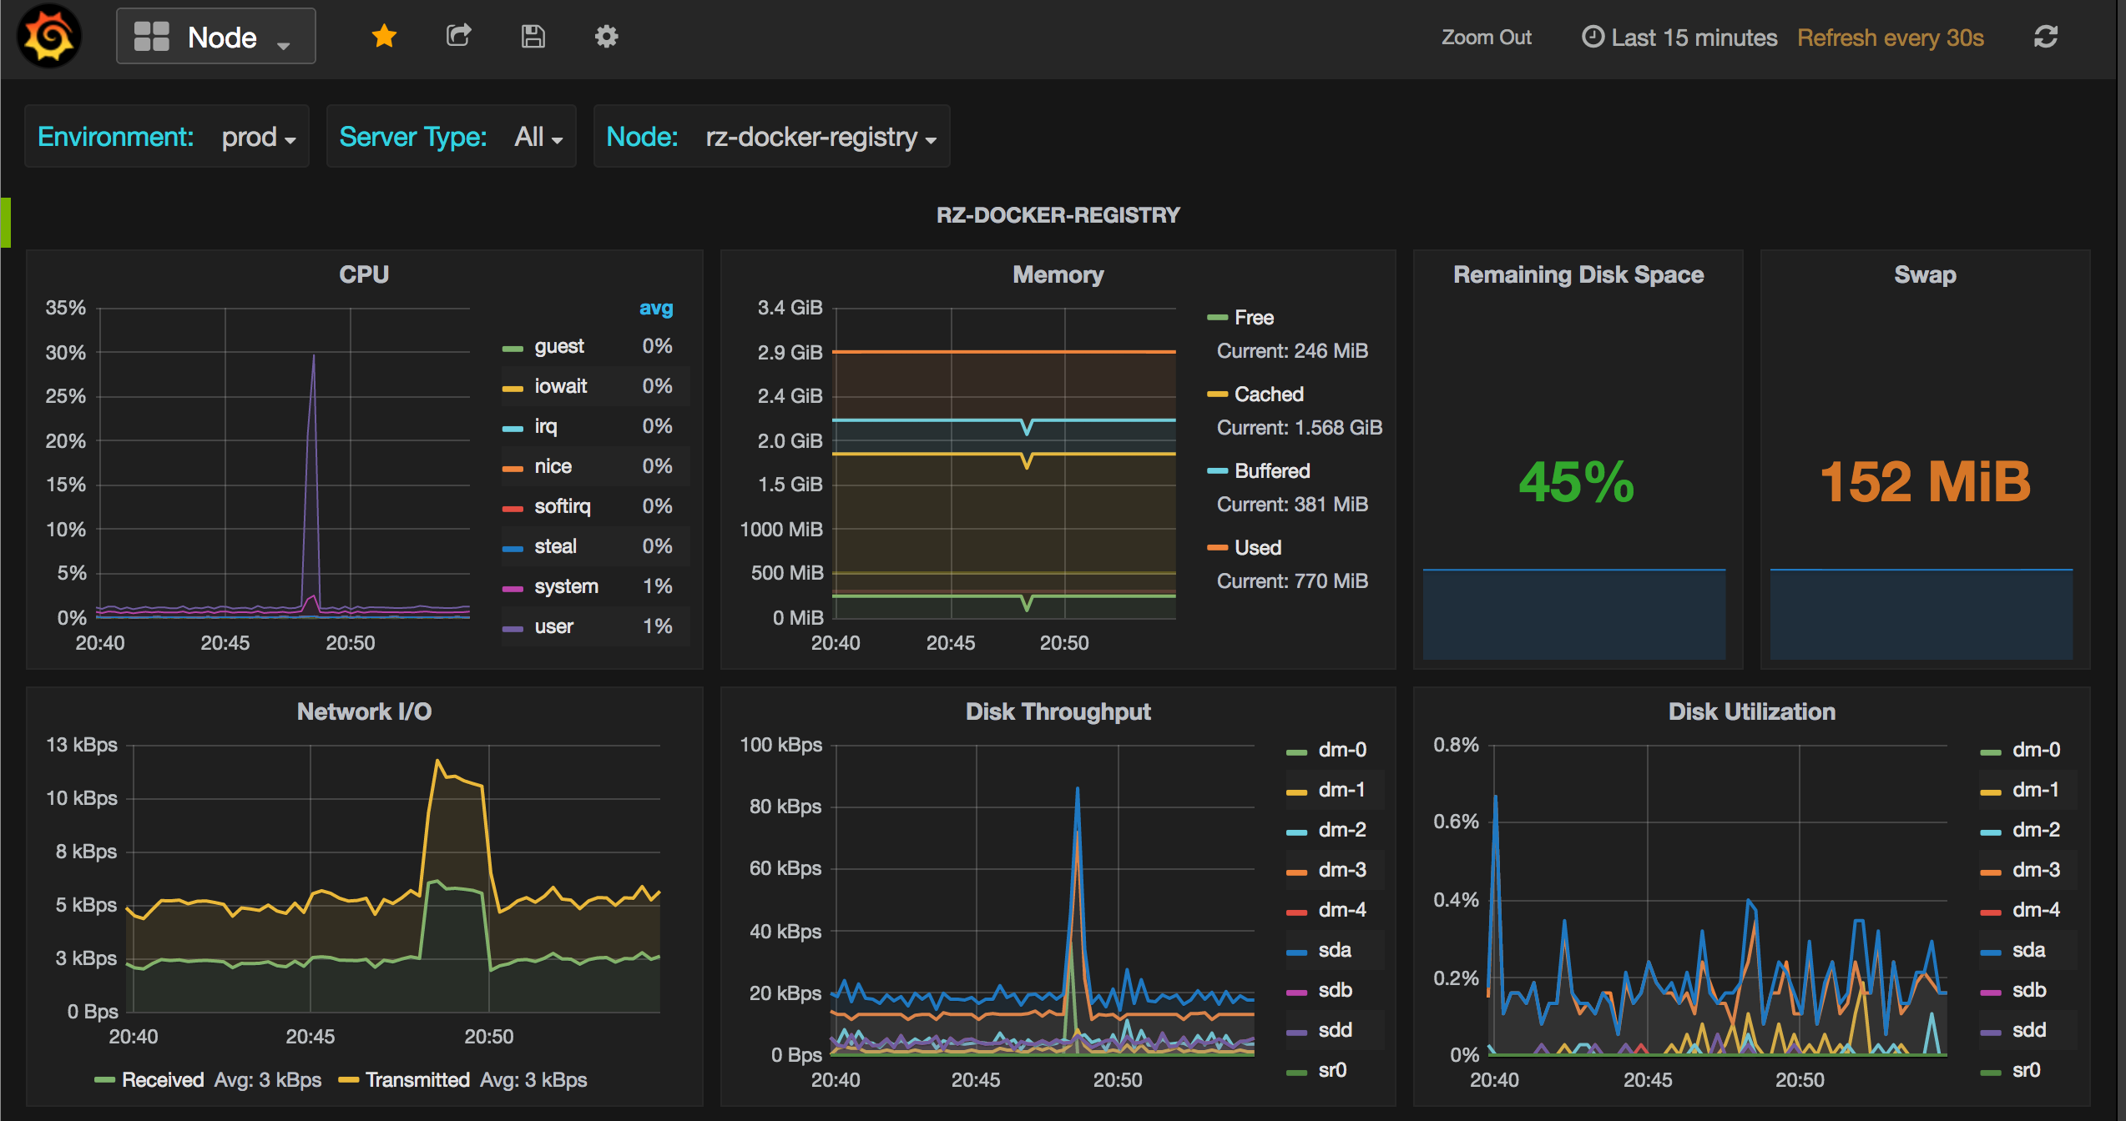
Prometheus
Open source systems monitoring and alerting toolkit
Second hosted CNCF project after Kubernetes
Collects and stores metrics as time series data

Slide 27
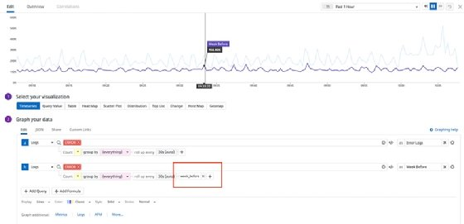
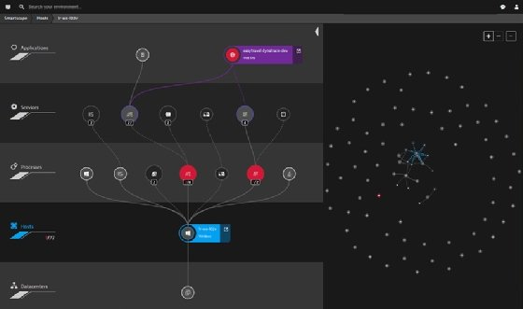
Observability Tools
AppDynamics (Cisco)
Datadog
Splunk
Grafana
Dynatrace
Lightstep

Slide 28
Land Acknowledgement Statement
We respectfully acknowledge the University of Arizona is on the land and territories of Indigenous peoples. Today, Arizona is home to 22 federally-recognized tribes, with Tucson being home to the O’odham and the Yacqui. Committed to diversity and inclusion, the University strives to build sustainable relationships with sovereign Native Nations and Indigenous communities through education offerings, partnerships, and community service.

